Slide 1
Title of the Session:
Concept of Blended Learning
Different formats and levels of e-learning
Limitations and Challenges
(09.00 AM - 11.00 AM)

Slide 2
Zahed Ahmed Chowdhury
Chief Instructor & HoD (1st shift)
Department of Computer Science & Technology
Dhaka Polytechnic Institute
zahed.sylhet@gmail.com
https://www.youtube.com/c/ZahedAhmedChowdhury/

Slide 3
Session Outcome:
Face to Face Teaching & Learning
Concept of E-Learning
Concept of Blended Learning
Different formats and levels of E-learning
Limitations and Challenges

Slide 4
Face to Face (F2F) Teaching & Learning:
Characteristics:
an instructional method where course content and learning material are taught in person to a group of students.
A Teacher-Centered Learning Method.
Live interaction between the instructor and the learner.
Fixed time and date to conduct the session.

Slide 5

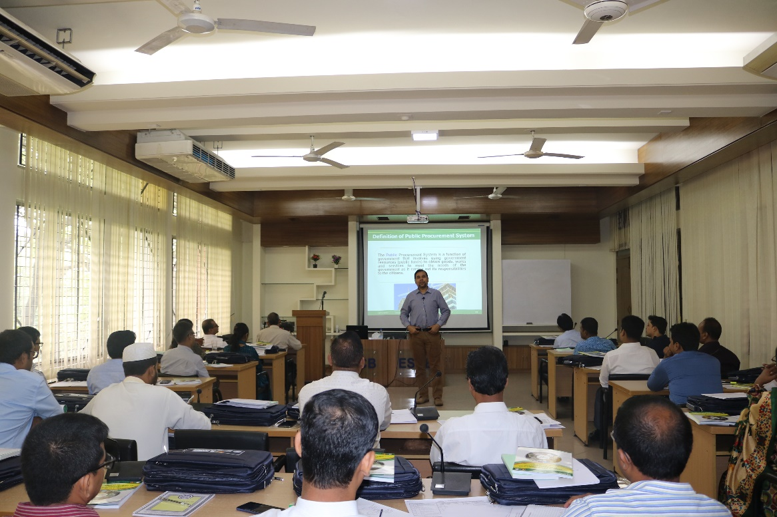
Types of F2F Learning:
Traditional F2F Learning:
ICT Integrated F2F Learning:

Slide 6
Advantages of F2F Learning:
1. Encourages and helps with Social Skills
The opportunity to enter a classroom with other students and have that social interaction.
2. Real-time Interaction
You can receive help at the exact moment you need it.
3. Lack of Distraction
Except for some individuals, many find the familiarity for their home a massive distraction.
4. Promotes Collaborative Learning
Prepare how to work in a team environment in workplace.
5. Encourages critical thinking
To engage in live discussions and relevant debates.
6. Teaches accountability and Responsibility
Don’t have the option to say, “I’ll just watch the class and do the work later”.
(MyPathEducation.edu.au)

Slide 7
Limitation of F2F Learning:
A Teacher-Centered Learning Method
Cost is an expensive form of learning
Travel time can be a huge problem for students
There are no flexibility choices for students
Pace of learning is determined by the teachers and not the students
[Several education systems have now shifted from this type of learning by understanding the changing needs of the students]

Slide 8
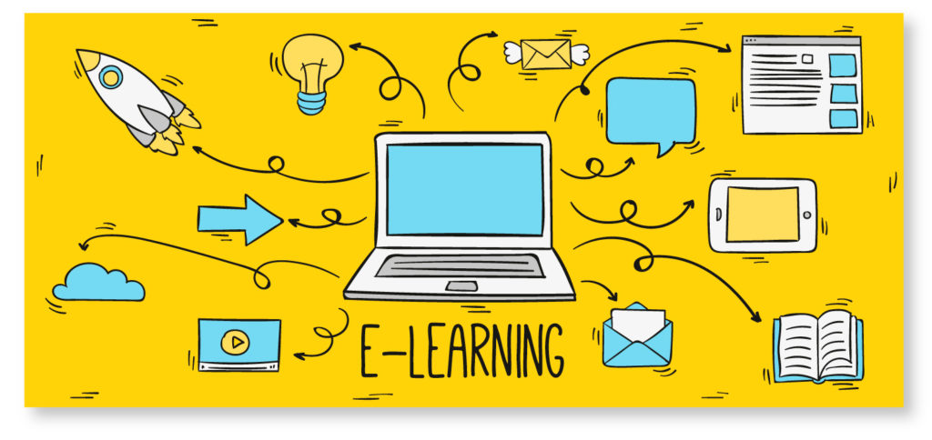
E-learning?

Slide 9
E-learning?
A learning system based on formalized teaching but with the help of electronic resources is known as E-learning.
Teaching can be based in or out of the classrooms, the use of computers and the Internet forms the major component of E-learning.
E-learning can also be termed as a network enabled transfer of skills and knowledge.
The delivery of education is made to a large number of recipients at the same or different times.
Earlier, it was not accepted wholeheartedly as it was assumed that this system lacked the human element required in learning.

Slide 10
e-Learning & Online Learning:
e-Learning allows the students to interact with their teacher only through the internet. They cannot learn or communicate with their teacher even if they are in the same premises.
Online, on the other hand, allows the students to use a virtual conferencing software like Zoom, Google Meet, MS Team, ezTalks Cloud Meeting etc. to interact with their teacher face-to-face along with learning online through the internet.
[in generally/broad sense both are the same meaning]

Slide 11
Different formats and levels of e-learning:
1. Fixed e-Learning
2. Adaptive e-Learning
3. Asynchronous e-Learning
4. Interactive e-Learning
5. Individual e-Learning
6. Collaborative e-Learning

Slide 12
Fixed eLearning:
All learners receive the same type of information as determined by the instructors.
Pros:
Fixed e-Learning works well when the learning depends on a time-sensitive completion schedule involving fixed curriculums.
It may be easier and more time sensitive for trainers to implement a one-sized-fits-all strategy, with less variation.
Cons:
Due to its rigidity, it would be hard to adapt to the current diverse e-Learning needs.
It is a generalized form of learning that fails to consider each student’s individual learning abilities.

Slide 13
2. Adaptive eLearning:
Adaptive eLearning has the learner’s flexibility as its focal point.
Pros:
Adaptive learning is flexible, allowing you to take courses based on your individual needs.
Cons:
Since adaptive eLearning is tailor-made for each student, instructors planning it face setbacks trying to meet the enormous number of e-Learning schedules on a wide-scale level.

Slide 14
3. Asynchronous eLearning:
flexible individual schedules, allowing personalized and individualized learning time frames.
Pros:
takes into account the need for flexible individual schedules, allowing personalized and individualized learning time frames.
Learners at different geographical areas also benefit from the same learning tools available to their peers.
Cons:
Asynchronous e-Learning can lead to isolation, creating a ripple effect in complacency while studying. Some learners require constant evaluation and interaction with their peers to keep pace, which lacks here.

Slide 15
4. Interactive e-Learning:
In interactive e-Learning, both teachers and students can communicate freely. An open line of communication also allows for better interaction, resulting in a better learning process should any queries arise.
Pros:
The open form of communication gives rise to a seamless process of learning, for both learners and teachers.
Open communication also strengthens independence in learning for students, since you have a say in the learning process.
Cons:
Not suited for large numbers of online learners, as it leads to confusion (mainly for the instructors).

Slide 16
5. Individual e-Learning:
Individual eLearning is all about students learning on their own without any peer communication
Pros:
Individual eLearning helps students learn based on personal attributes such as goal achievements rather than relying on their teachers’ and peers’ standards.
Cons:
It restricts all forms of communication, resulting in isolation. Here, you are required to learn solely on your own and complete your goals by yourself. Due to the lack of follow-up, individual eLearning can only work in highly specialized situations where learners are highly motivated and skilled.

Slide 17
6. Collaborative e-Learning:
Focuses on teamwork, allowing students to work together. Learning materials and goals rely on combined effort.
Pros:
Promotes communication and teamwork among the students, an aspect that is often lacking in online learning.
It also develops critical thinking that is needed to accommodate different students’ views during the learning process. Due to its collaborative design, it can work well with learners from different backgrounds and cultures.
Cons:
Can give rise to over-dependence by some students.

Slide 18


Slide 19
Self Study:
What type of e-Learning format do you choose for
you institute and Why?

Slide 20
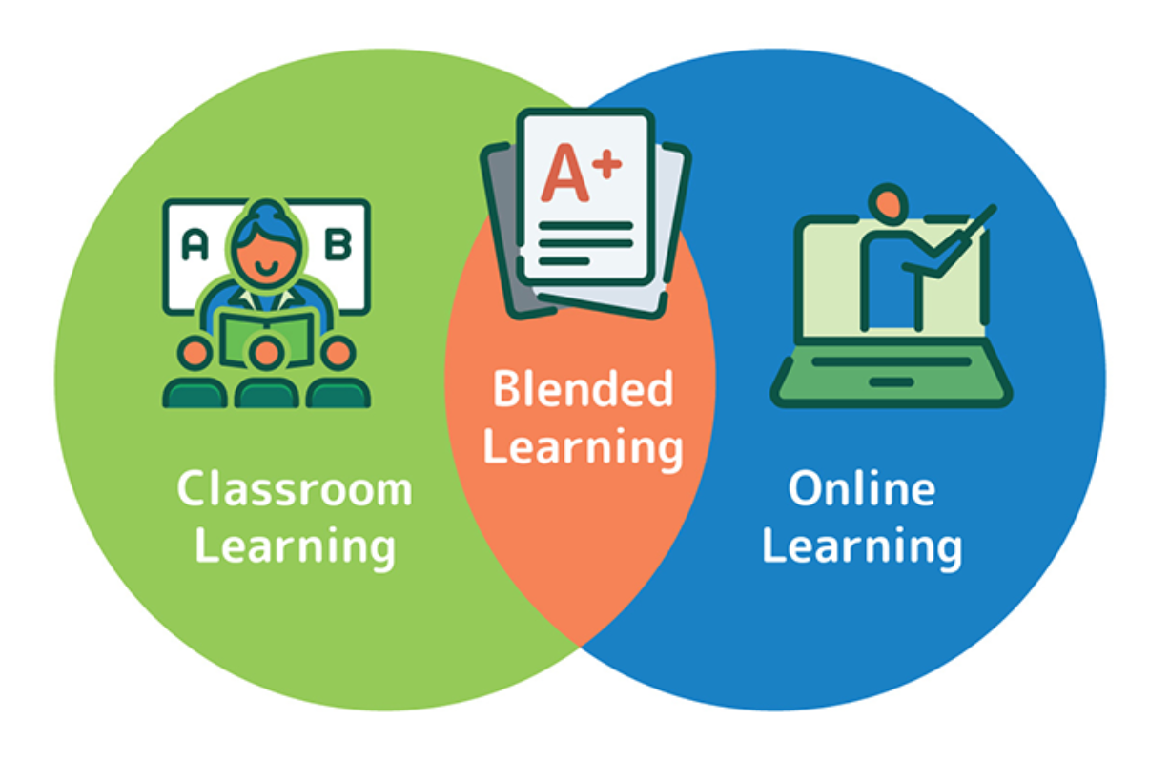
Blended Learning:

Slide 21
Blended Learning:
An approach to education that combines online educational materials and opportunities for interaction online with traditional place-based classroom methods. (Wikipedia)
also known as:
Hybrid learning or Technology-mediated instruction or Web-enhanced instruction or Mixed-mode instruction.

Slide 22
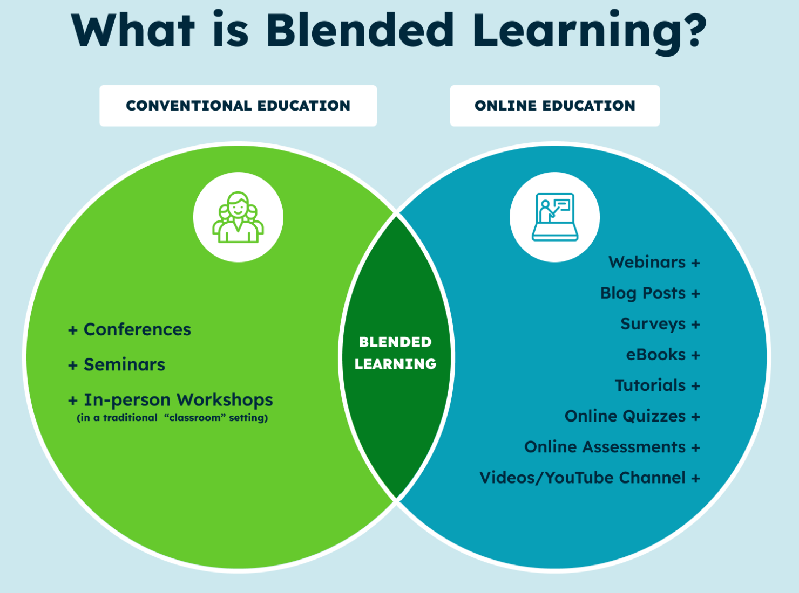
Blended Learning:

Slide 23
Different Types of Blended Learning Models:
The Face-To-Face Driver Model
The Rotation Model
The Flex Model
Online Lab School Model
Self-Blend Model
The Online Driver Model

Slide 24
1. The Face-To-Face Driver Model:
This model works best for diverse classrooms in which students are functioning at various levels of ability and mastery.
In general, only some students will participate in online learning components.

Slide 25
2. The Rotation Model:
This is really just a variation of the learning stations model that teachers have been using for years.
There is a set schedule by which students have face-to-face time with their teachers and then move to online work.

Slide 26
3. The Flex Model:
This model relies heavily on online instructional delivery, with teachers acting as facilitators rather than as primary deliverers of instruction.

Slide 27
4. Online Lab School Model:
This model involves students traveling to and attending a school with total online educational delivery for entire courses.
There are no certified teachers on hand, but, rather, trained paraprofessionals who supervise.

Slide 28
5. Self-Blend Model:
This model allows coursework beyond that offered in a tradition setting in a specific school or district.
Students participate in traditional classes but then enroll in courses to supplement their regular programs of study.

Slide 29
6. The Online Driver Model:
This model is the complete opposite of a traditional face-to-face instructional environment. Students work from remote locations (e.g., their homes) and receive all of their instruction via online platforms.
Usually, there are opportunities to “check-in” with a course teacher and to engage in online messaging if an explanation is needed.

Slide 30
Advantages of Blended Learning:
is equitable
develops technological soft skills
is cost-effective
is flexible
can bring parents on board
can make personalized learning a reality
can boost engagement
keeps classroom connections alive

Slide 31
Limitations and Challenges:
1. The technology challenge (Infrastructure):
Need to building an essential infrastructure within an educational institution or particular class.
May software and hardware technology for blended learning program can be costly for Teacher as well as students.
2. The technology challenge (Mentality):
IT literacy, which may be a significant barrier for teachers rather than students.

Slide 32
Limitations and Challenges:
3. Pace of advancement:
All students are not some streams of Pace of Advancement.
At the end of the day, an instructor trying to sync up both streams with ongoing offline activity which is a difficult task.
4. Negative impact on teachers (Overwork):
There’s a significant amount of extra teacher’s work involved in the primary stages.
Need a right syllabus and right ratio between F2F & Online learning.

Slide 33
Limitations and Challenges:
5. Negative impact on students (Cognitive load):
some teachers may start over delivering content and educational activities which is increase the cognitive load of students.
6. The plagiarism and credibility problem:
It’s a great challenge for the Instructor to assess the students fairly.

Slide 35
Group work:
Prepare a presentation about challenges of e-Learning/Blended Learning implementation in TVET sector of Bangladesh.

Slide 36



